Slide 1

Writing Your Own Encryption Routines in SQL
SQL Undercover
presents
…and cracking them
David Fowler

Slide 2






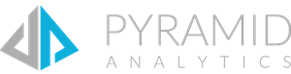










PLATINUM SPONSOR
GOLD SPONSORS
SILVER SPONSORS
BRONZE SPONSORS

Slide 3


Notes:
Image is in public domain:
https://www.publicdomainpictures.net/en/view-image.php?image=260306&picture=gdpr

Slide 4
Please give us your feedback:
sqlrelay.co.uk/feedback
Thank you

Slide 5

All About David Fowler
15 Years as a SQL Server DBA
www.sqlundercover.com
Keen Cyclist
david@sqlundercover.com
LinkedIn
Facebook
Twitter (@SQL_Undercover)
Strava (for any cyclists out there)

Slide 6
Agenda
The Arcane Sciences
XOR Cypher
Caesar Cypher
XOR – Caesar Collaboration
Pimp My Cypher
Shifting the Key

Slide 7
Disclaimer
The encryption routines in this presentation are purely for demonstration purposes. David Fowler and SQL Undercover cannot be held liable for any damages that may arise from using them.
In short, if you use these in production and someone nicks all your top secret data….
DON’T COME CRYING TO ME

Slide 8
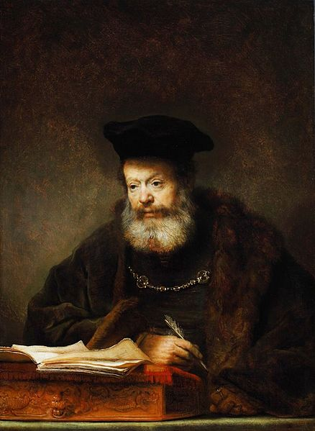
The Arcane Sciences
Binary
Bitwise Logic

Slide 9
Binary
Some funky code that’s used by computers and is made up of 1s and 0s
Base Two Counting System
Each Bit (Binary Digit) can have one of two values, 1 or 0
Each Bit represents a power of 2
8 bits form 1 byte

Slide 10
Binary
To Understand binary we first need to understand decimal or base 10
Each digit can have 1 of 10 values (0,1,2,3,4,5,6,7,8,9)
But what happens when we have a number greater than 9?
We simply add another digit to the left.
That means that every digit is worth 10 times the digit on the right.
10,000,000 | 1,000,000 | 100,000 | 10,000 | 1,000 | 100 | 10 | 1

Slide 11
Binary
Think about the number 3578
1000 | 100 | 10 | 1
3 | 5 | 7 | 8
8x1
+ 7x10
+ 5x100
+ 3x1000
8 + 70 + 500 + 3000 = 3578

Slide 12
Binary
Binary works in a very similar way to our base 10 system
Instead of 10 possible digit values binary only has 2
1 and 0
So each bit in worth 2 times the bit on the right
128 | 64 | 32 | 16 | 8 | 4 | 2 | 1

Slide 13

Binary
O
O
O
O
So let’s take a look at the byte, 11010010
128 | 64 | 32 | 16 | 8 | 4 | 2 | 1
1 | 1 | 0 | 1 | 0 | 0 | 1 | 0
1x2
+ 1x16
+ 1x64
+ 1x128
2 + 16 + 64 + 128 = 210

Slide 14
Bitwise Logic
How does bitwise logic differ from boolean logic?
Boolean logic acts on two booleans.
WHERE customer_location = ‘England’ AND purchases > 20
Boolean logic gives us three operators (we’re going to ignore NOT for now)
AND
OR
XOR (Exclusive OR)

Slide 15
Bitwise Logic
DEMO:
BOOLEAN LOGIC IN ACTION

Slide 16
Bitwise Logic
Bitwise logic has very similar operators to boolean logic
& - bitwise AND
| - bitwise OR
^ - bitwise XOR
Bitwise logic works on the individual bits of a value

Slide 17
Bitwise Logic
DEMO:
BITWISE LOGIC IN ACTION

Slide 18
Bitwise Logic
i
11011100 = 220
10110001 = 177
0
0
0
0
0
0
= 144
1
1

Slide 19
XOR Cypher
Used in many more complex algorithms including AES and DES
To encrypt, XOR is applied to the key and the plaintext
To decrypt the process is simply reversed

Slide 20
XOR Cypher in SQL
Example, to encrypt the plaintext ‘DataRelay’
SQL can only apply bitwise logic to BIT, INT, SMALLINT, TINYINT, BIGINT (and (VAR)BINARY with a caveat)
Convert textual data into TINYINT by using each character’s ASCII code
XOR an 8bit key against each byte of the plaintext
Convert each encrypted ASCII code back into it’s character representation to reveal the cyphertext

Slide 21
XOR Cypher
We’ve done it!
We can securely encrypt our data!
Cypher Cracked!

Slide 22
Cracking the XOR Cypher
Our cypher has one big weakness…
The length of the key
A single byte (8 bit key) key has only 256 possible values
That leaves it VERY vulnerable to…
BRUTE FORCE ATTACK!!!

Slide 23

Brute Force Attack
The attacker simply tries every possible key value until they find one that works.

Slide 24
Brute Force Attack
DEMO:
BRUTE FORCE ATTACK!

Slide 25
Beef Up The Algorithm
Make a longer key
Increase the complexity of the algorithm
Very few modern encryption routines rely on a single method of encryption.
More methods of encryption make a more complex and more difficult cypher to crack.

Slide 26
Caesar Cypher
Allegedly invented by the Roman Emperor, Julius Caesar
Encryption is performed by shifting each character of plain text by a set number of characters in the alphabet
For example to encrypt ‘SQLUndercover’ we could shift each character by two, giving us…
'USNWpfgteqxgt‘
O P Q R S T U V W
h

Slide 27
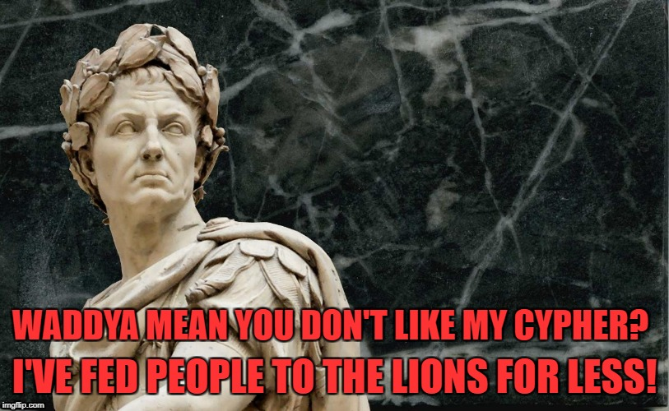
Implementing The Caesar Cypher
In SQL this could be performed by adding a numeric key to the character’s ACSII code
With 256 possible ASCII codes, there are 256 possible shift positions
This is no more secure than the XOR Cypher and just as vulnerable to a brute force attack

Slide 28
Combining XOR and Caesar Cyphers
What if we combine the XOR and Caesar Cyphers?
Perform the XOR Cypher followed by a character shift?
Our cypher suddenly becomes far more complex and difficult to crack.
The XOR cypher has 256 possible key values
The Caesar Cypher has 256 possible shift positions
Think about the numbers….
256
Key values
x 256
Shift positions
= 65,536
Key\Shift Combinations

Slide 29
XOR - Caesar Collaboration
DEMO:
XOR - Caesar
Collaboration!

Slide 30
XOR - Caesar Collaboration
We’ve done it!
We can securely encrypt our data!
Cypher Cracked!

Slide 31
Cracking The XOR - Caesar Collaboration
XOR-Caesar has one big weakness
It’s a straight substitution cypher
An unencrypted character’s encrypted counterpart will always be the same.
Let’s see that in action…
If we can work out what an encrypted character represents we’ll know all the occurrences of that character.
Substitution cyphers are VERY vulnerable to
STATISTICAL ATTACK!!!

Slide 32
Statistical Attack
Substitution cyphers are vulnerable to a statistical attack also known as statistical analysis or frequency analysis
Certain letters and combinations of letters in the English language occur more often than others.
By analysing the cypher text we have a good chance of identifying these common patterns.
E | T | A | O | I | N | S | R | H | D
12.02% | 9.10% | 8.12% | 7.68% | 7.31% | 6.95% | 6.28% | 6.02% | 5.92% | 4.32%
Z | J | Q | X | K | V | B | P | G | W
0.07% | 0.10% | 0.11% | 0.17% | 0.69% | 1.11% | 1.49% | 1.82% | 2.03% | 2.09%

Slide 33
Statistical Attack
DEMO:
STATISTICAL ATTACK!

Slide 34
Pimp Up The Key
To avoid being vulnerable to a statistical attack we need to make sure that a character isn’t always encrypted the same way.
Look what happens when we encrypt the string AAAA as we have been doing, using an 8bit key.
01000001 01000001 01000001 01000001
10011100 10011100 10011100 10011100
10011101 10011101 10011101 10011101
The resultant, encrypted characters are always the same.

Slide 35
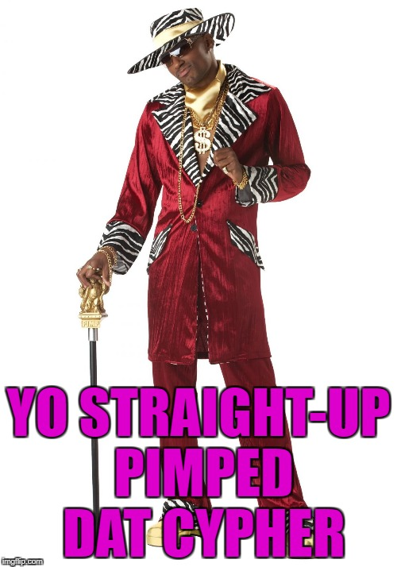
Pimp Up The Key
What happens if we try to encrypt the data using a 32bit key?
01000001 01000001 01000001 01000001
11110000 00001111 10101010 01010101
10110001 01001110 11101011 00010100
This means that every character, even if they all started out the same, will be encrypted differently.
It’s far more difficult to carry out a statistical attack.
But how’s it do against a brute force attack?
With just under 3 million possible key values, I’d say it does quite well.

Slide 36
Pimp Up The Key
DEMO:
PIMPED UP XOR CYPHER

Slide 37
Pimped Up XOR Cypher
We’ve done it!
We can securely encrypt our data!
Cypher Cracked!

Slide 38
Plain Text Attack
Analysis of the cypher text and part of the plain text can reveal the whole or part of the key.
XOR cyphers, regardless of key length are susceptible to plain text attacks.

Slide 39
Plain Text Attack in Action
Plain Text 10111001
Key 10101010
Cypher Text 00010011
Now look what happens if we try to XOR the plain text and cypher text
Plain Text 10111001
Cypher Text 00010011
10101010
The key is revealed

Slide 40
Plain Text Attack
So if we can discover a portion of the plain text, we can use that to retrieve the key and crack the rest of the message.
The following was encrypted with a 16bit key
Cypher Text 01101100 01110101 1100100 1011100 11001100
Known Plain Text 01100100 01101111 xxxxxxxx xxxxxxxx xxxxxxxx
We don’t even need to reveal the whole key, just a single byte in the above example will allow us to decrypt half the characters in the message.
From there a further statistical attack or brute force attack could be used to reveal the rest.

Slide 41
Plain Text Attack
DEMO:
PLAIN TEXT ATTACK!

Slide 42
Bit Shift
What is a bit shift?
A bit shift simply shifts the bits of a byte either left or right by a specified number of positions
10000001 << 1
1
0
0000001

Slide 43
Circular Bit Shift
Similar to a standard bit shift except that the most significant bit is moved to the position of the least significant bit
1
0000001

Slide 44
Performing a Bit Shift in T-SQL
That means that we can cheat in T-SQL, multiplying by 2 will have the same effect as a left bit shift
T-SQL unlike some languages doesn't provide us with a bit shift operator
00000001 = 1
Bit shift by 1
00000010 = 2
Bit shift by 1
00000100 = 4
Notice a pattern?

Slide 45
What About An Overflow?
Usually when we perform a left bit shift the MSB (most significant bit) is dropped off.
This causes us an issue in T-SQL.
Either SQL will exceed the maximum value for the data type and error
or the value will simply exceed what we’re expecting.
Before shifting, we need to check the value of the MSB.
Bitwise logic IF (BYTE & 1000000) > 0
The simpler way is to check if the value is greater than that of the MSB
If an overflow is detected, subtract the value of the MSB from the value before shifting

Slide 46
How About a Circular Bit Shift in T-SQL
A circular bit shift is fairly simple
First check for an overflow
If an overflow is detected, deal with it in the way described earlier, double the value and then add 1.
If an overflow is not detected, there’s no need to add 1 after the shift.

Slide 47
Shift The Key
How can we make an algorithm that’s resilient to a plain text attack?
Look at the following example of an XOR encryption…
Plain Text | 0 | 1 | 1 | 0 | 0 | 1 | 0 | 1
Key | 1 | 1 | 1 | 1 | 0 | 0 | 0 | 0
Cypher Text | 1 | 0 | 0 | 1 | 0 | 1 | 0 | 1
Plain Text 01100101
Cypher Text 01110100
Key << 1 | 1 | 1 | 1 | 0 | 0 | 0 | 0 | 1
Cypher Text | 0 | 1 | 1 | 1 | 0 | 1 | 0 | 0
00010001
Algorithms such as DES use multiple rounds of encryption, bit shifting the key each time to protect against plain text attacks.

Slide 48
Shift The Key
DEMO:
Shifting The Key

Slide 49
One Final Question….
When SQL Server give us so many great ways to encrypt our data….
WHAT’S THE POINT OF HAND CRANKING OUR OWN?

Slide 50

SQLUndercover.com

